Slide 1
PFA HOUSING PROJECT
Data Scientist Name: Vaibhav Tayade
Date: 23-09-2021
(Submited as a part of internship projects)

Slide 2
Aknowledgement
Special thanks to Sapna Verma madam for guiding me for this project.
And also thanks to Deepika Sharma madam, for teaching us this skills to perform data analysis.
This project is submitted to fliprobo company as a part of internship projects.

Slide 3
INTRODUCTION
A US-based housing company named Surprise Housing has decided to enter the Australian market. The company uses data analytics to purchase houses at a price below their actual values and flip them at a higher price. For the same purpose, the company has collected a data set from the sale of houses in Australia. The data is provided in the CSV file.
A Data analysis is done on the dataset to gain some important feature which affects the property sale price.

Slide 4
Steps Perfomed in Data Analysis
1) Data Cleaning
2) Data Analysis
3) Data Visualization
4) Outliers and Skewness
5) Studying Correlation matrix
6) Label Encoding the categorical data
7) Scaling the Dataset
8) Train-Test Split
9) Machine Learning model building
10) Hyper Parameter Tuning of the best model
11) Checking Accuracy of the model
12) Saving the model.

Slide 5
Data Cleaning
1) Data cleaning is a very important step because many times data contains Null values or ‘0’ values, we need to deal this values so that it doesn’t hamper our model building in the end.
2) We removed columns having Null values more than 50%.
3) We replaced Null values with mean, median or mode values of the at columns with respect to the distplot of that particular column.
4) We ensured there are no Null values left by plotting heatmap.

Slide 6
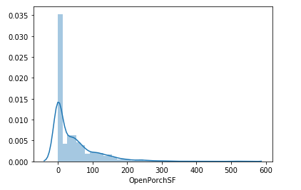
Data Analysis
Box plot, Distplot, Scatter plot are used inorder to do data analysis and gain some information out of it.
Distplot:
It shows that the OpenPorchSF Columns is having dataset skewed on the right hand side.
Likewise skewness of all columns have been checked.

Slide 7
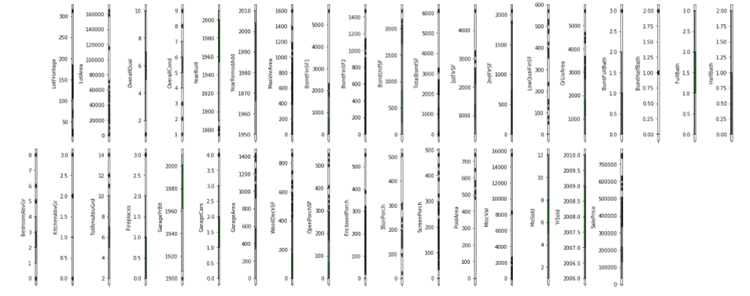
Box Plot Analysis
Observation: We can see there are presence of outliers in almost all columns.

Slide 8
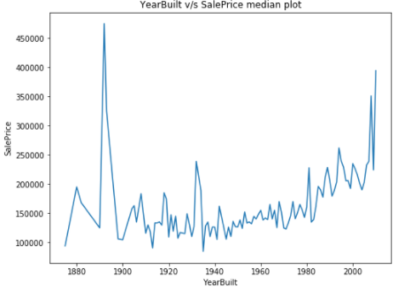
Bivariate Analysis
Observation: We can see that from the shown median plot, most of sale price ranges from 100000 to 150000 of all yearbuilt range. We can also see that from 1885 to 1990 yearbuilt range, we see huge sale price growth. we can see also see sudden growth in sales price from 1980 to 2000 and above years.
Likewise we did data analysis of various other columns with sales prices as well.

Slide 9
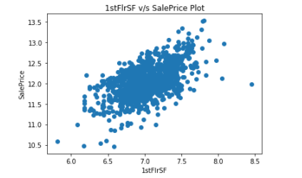
Bivariate Analysis
Observation: Most of the Sales Price values range from 11.0 to 13.0 and Most of the 1stFlrSF values range from 6.2 to 7.8. Most of the dataset are linearly spreaded.
Likewise we did analysis of scatter plot of other columns with sale price.

Slide 10
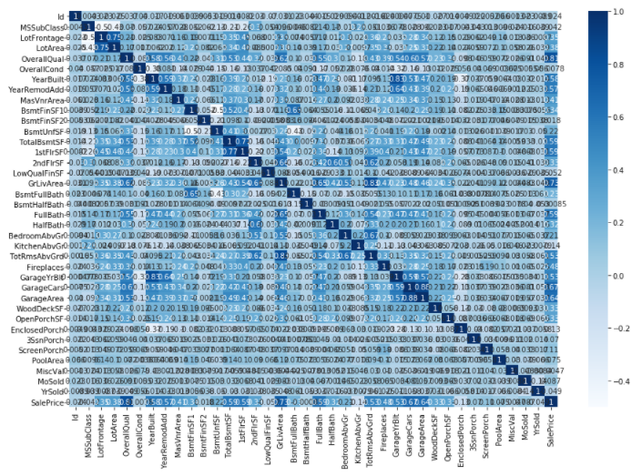
Correlation matrix

Slide 11
Correlation matrix
Observation: We can see that there are various columns which are highly correlated with the Sales price, like LotArea, OverallQual, YearBuilt, YearRemodAdd, MasVnrArea, GrLivArea, GarageCars, GarageArea etc.

Slide 12
Machine Learnings models and their accuracy:
Linear Regression: LinearRegression Model has shown accuracy score of 86.29%
Lasso regression (regularization): Lasso regression model has shown accuracy of 86.29%
Ridge regression (regularization): Ridge Regression model has shown accuracy of 86.29%
ElasticNet Regression: ElasticNet Regression model has shown accuracy of 86.29%

Slide 13
Random Forest Regression: Random Forest Regression model has shown accuracy of 97.93%
Support Vector Regression: Support Vector Regression model has shown accuracy of 10.13%
Ada Boost Regression: Ada Boost Regression model has shown accuracy of 88.12%
Observation:
After checking all models accuracy score and cross validation score and also their errors, we found out that Ada Boost Regressor seems to be the best model, as it has good accuracy score and least error comparatively. The difference between the accuracy score and cross validation score is also minimal.

Slide 14
Hyper Parameter Tuning Model:
After Hyper parameter tuning the model we found out that below parameters are best parameters in order to make final model.
learning_rate: 2, loss: exponential, n_estimators: 150, random_state: 42
Our final model is made using best parameters obtained in hyper parameter tuning, we found out the accuracy of 88.43% earlier it was 88.12% which is slightly increased by 0.31%.
So we can now finally say that our model is having accuracy of 88.43%.

Slide 15
Conclusion
1) Ada Boost Regression model is the best fit model for PFA Housing Project Sales Prices Prediction.
2) Our model is having accuracy of 88.43%.
3) LotArea, OverallQual, YearBuilt, YearRemodAdd, MasVnrArea, GrLivArea, GarageCars, GarageArea are highly correlated with the sales prices.
4) We can also see sudden growth in sales price from 1980 to 2000 and above years with compared to YearsBuilt.
5) In this dataset, Outliers cannot be removed because they are holding intrinsic property of the dataset.

Slide 16
THANK YOU

